Slide 1
Artificial Intelligence
Dr. Annapurna P Patil
Associate Professor
Department of Computer Science and Engineering
M S Ramaiah Institute of Technology
Bangalore-54
annapurnap2@yahoo.com,annapurnap2@msrit.edu
Ph: 9945409177

Slide 2
Acknowledgement
……The Internet

Slide 3
Artificial Intelligence
Course Overview
Books to be referred
Course evaluation method

Slide 4
Objective of this course
Artificial intelligence (AI) is the study of ideas that enable computers
to be intelligent. The goals of the field of artificial intelligence are to
make computers more useful and to understand the principles that
make intelligence possible. This course will cover the following
topics: introduction of AI and intelligent agents, problem solving and
search methods, knowledge representation, planning, reasoning,
reasoning under uncertainty, and learning mechanism.
Upon successful completion of this course, the student should be able to
(1) understand basic ideas of artificial intelligence,
(2) master essential techniques of artificial intelligence,
(3) apply the techniques to a simple problem solving or intelligent controls

Slide 5
More AI definitions
  AI is a collection of hard problems, which can be solved by humans and other living things, but for which we don’t have good algorithmic solutions.
    e.g., understanding spoken natural language, medical diagnosis, circuit design.

Slide 6
Intelligence
  Intelligence is difficult to define and understand, even for philosophers and psychologists who spend their lives studying it. But this elusive quality is, to many people, the characteristic that sets humans apart from other species.

Slide 7
Intelligence
What is intelligence, anyway? It is only a word that people use to name those unknown processes with which our brains solve problems we call hard. But whenever you learn a skill yourself, you are less impressed or mystified when other people do the same.
This is why the meaning of “intelligence” seems so elusive: It describes not some definite thing, but only the momentary horizon of our ignorance about how minds might work.”
- Marvin Minsky, AI researcher

Slide 8
What is Artificial Intelligence?
Smart programs? Not really. Studying what is possible and underlying theories are very important.
    E.g. How does a slow, tiny brain (biological or electrical) perceives, understands, and manipulates a complex world?
Currently encompasses a large variety of subfields,
  from general areas such as perception and logical reasoning to
  specific tasks such as playing chess, writing poetry…
  bringing together philosophy, logic, computer science, cognitive science and cognitive neuroscience

Slide 9
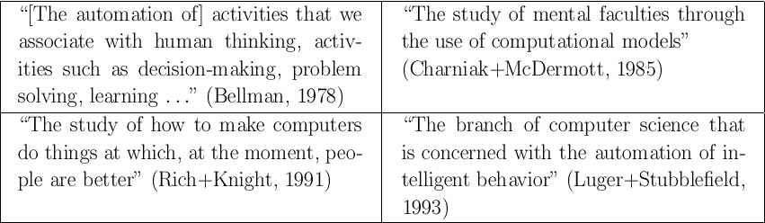
What is AI?
So defining artificial intelligence (AI) is hard.
In general, artificial intelligence is the field of science devoted to making computers perceive, reason, and act in ways that have, until now, been reserved for human beings.
Historical definitions (acting or thinking x humanly or rationally):

Slide 10
Why AI?
Engineering: To get machines to do a wider variety of useful things:
  e.g., find the best travel plan for your vacation, etc.
Cognitive Science: As a way to understand how natural minds and mental phenomena work:
  e.g., visual perception, memory, learning, language, etc.
Philosophy: As a way to explore some basic and interesting philosophical questions:
  e.g., the mind body problem, what is consciousness, etc.
Medicine: As an automated doctor to know the patience disease:
  e.g., the blood pressure machine, and medical expert systems.

Slide 11
Foundations of AI
Computer
Science &
Engineering
Mathematics
Philosophy
AI
AI
Economics
Biology
Psychology
Linguistics
Cognitive
Science

Slide 12

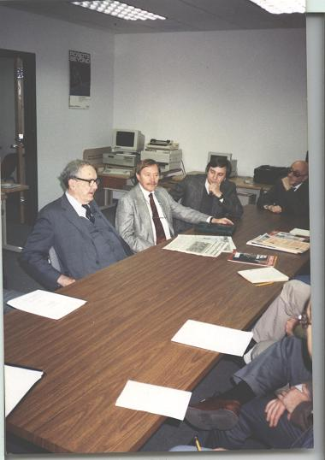
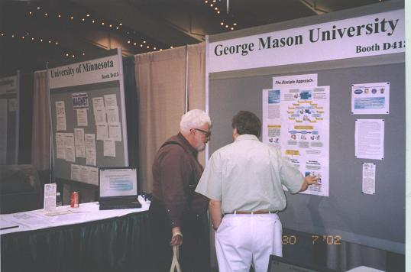
History of Artificial Intelligence
Stone age (1943-1956)
Early work on neural networks and logic (Herbert Simon,1943)
Birth of AI: Dartmouth workshop - summer 1956
John McCarthy’s name for the field: artificial intelligence
Herbert Simon in 1991
John McCarthy in AAAI-2002

Slide 13
Early enthusiasm, great expectations (1952-1969)
Dark ages (1969-1973)Why?
AI did not scale up: combinatorial explanation.
Failure of natural language translation approach based on simple grammars and word dictionary.
Funding for natural language processing stopped.
Failure of perceptrons to learn such a simple function.
Realization of the difficulty of the learning process.
There is no Symbolic concept learning.

Slide 14
Renaissance (1969-1979)
Change of problem solving paradigm: From search-based problem solving to knowledge-based problem solving.
Industrial age (1980-present)
Building expert systems with formal knowledge acquisition techniques.
There exists successful commercial expert systems.
Many AI companies.
Exploration of different learning strategies.
Reasoning, Genetic algorithms, Neural networks, etc.)

Slide 15
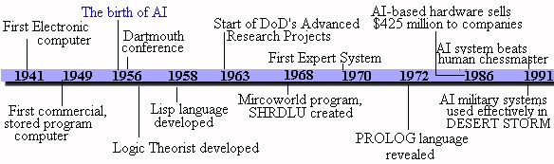
The Maturity and return of neural networks (1986-1995)
Many successful applications of neural networks , machine learning, and data mining.
Base claims on theorems and experiments rather than on intuition.
Show relevance to real-world applications rather than toy examples.
The reinvention of the back propagation learning algorithm for neural networks and other optimization process.

Slide 16
Intelligent agents (1995-present)
The realization that the previously isolated subfields of AI (speech recognition, planning, robotics, computer vision, machine learning, knowledge representation, etc.) need to be reorganized when their results are to be tied together into a single agent design.
A process of reintegration of different sub-areas of AI to build a “whole agent”:
multi-agent systems;
agents for different types of applications, web search engine agents.
See the Site: http://www.stottlerhenke.com/ai_general/history.htm
for more details.

Slide 17
1997: The Deep Blue chess program beats the current world chess champion, Garry Kasparov, in a widely followed match.
First official Robo-Cup soccer match featuring table-top matches with 40 teams of interacting robots and over 5000 spectators.
Late 90's: Web crawlers and other AI-based information extraction programs become essential in widespread use of the world-wide-web.
Demonstration of an Intelligent Room and Emotional Agents at MIT's AI Lab. Initiation of work on the Oxygen Architecture, which connects mobile and stationary computers in an adaptive network.
2000: Interactive robot pets (a.k.a. "smart toys") become commercially available, realizing the vision of the 18th cen. novelty toy makers.
Cynthia Breazeal at MIT publishes her dissertation on Sociable Machines, describing KISMET, a robot with a face that expresses emotions. The Nomad robot explores remote regions of Antarctica looking for meteorite samples.
Today: See AI in the news: http://www.aaai.org/AITopics/html/current.html for history in the making!

Slide 18
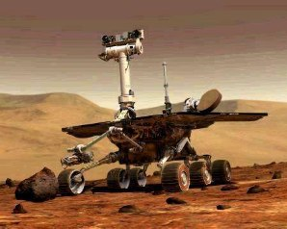
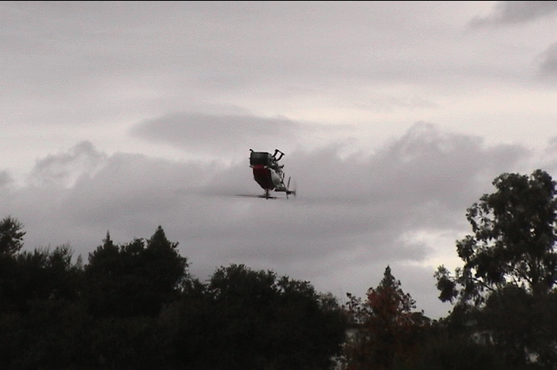
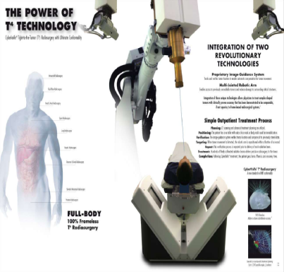
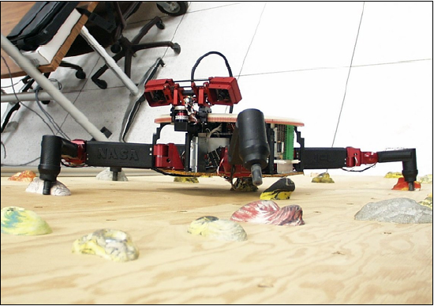
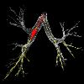

Some Achievements and State of the Art in AI
Computers have won over world champions in several games, including Checkers, Othello, and Chess, but still do not do well in Go
AI techniques are used in many systems and applications, e.g.: formal calculus, video games, route planning, logistics planning, pharmaceutical drug design, medical diagnosis, hardware and software trouble-shooting, speech recognition, road traffic monitoring, facial recognition, medical
image analysis, part inspection, etc...
Some industries (automobile, electronics) are highly robotized, while other robots perform brain and heart surgery, are rolling on Mars, fly autonomously, …, but home robots remain mostly a thing of the future

Slide 19
Typical Applications of AI
Optical Character Recognition (OCR): Scanning typewritten/handwritten documents, finger prints, etc.
Voice Recognition: Transcribing spoken words into ASCII text.
Medical Diagnosis: Assisting doctors with their diagnosis by analyzing the reported symptoms and/or medical imaging data such as MRIs or X-rays.
Oil Industry: To assist in predict PVT properties, Permeability Prediction, and Measure the reservoir Characterization,…etc.
Target Recognition: Military application which uses video and/or infrared image data to determine if an enemy target is present.
Targeted Marketing: Finding the set of demographics which have the highest response rate for a particular marketing campaign.
Intelligent Searching: An internet search engine that provides the most relevant content and banner advertisements based on the users' past behavior.
Fraud Detection: Detect fraudulent credit card transactions and automatically decline the charge.

Slide 20
What can AI systems do?
Here are some example applications
Computer vision: face recognition from a large set
Robotics: autonomous (mostly) automobile
Natural language processing: simple machine translation
Expert systems: medical diagnosis in a narrow domain
Spoken language systems: ~1000 word continuous speech
Planning and scheduling: Hubble Telescope experiments
Learning: text categorization into ~1000 topics
User modeling: Bayesian reasoning in Windows help (the infamous paper clip…)
Games: Grand Master level in chess (world champion), checkers, etc.

Slide 21
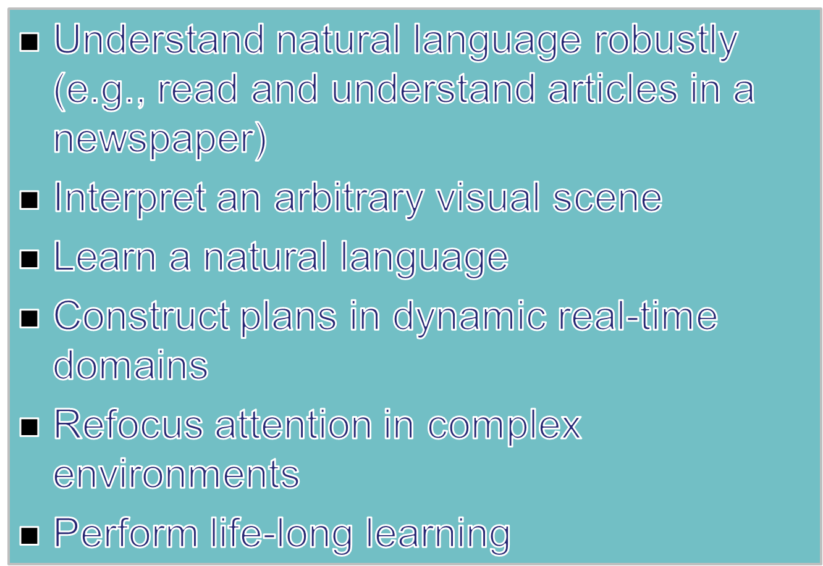
What can’t AI systems do yet?

Slide 22
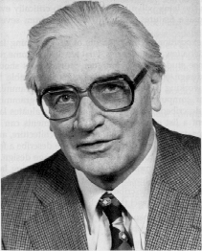

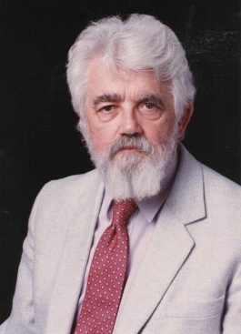


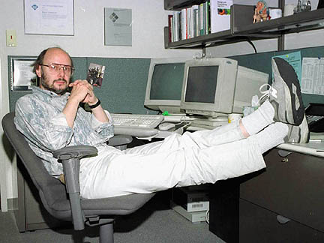
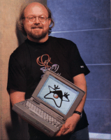

AI Common Programming Languages
Plankalkul
Fortran
Python
Konrad Zuse
John Backus
LISP
Prolog
C
John McCarthy
MATLAB
C++
Java

Slide 23
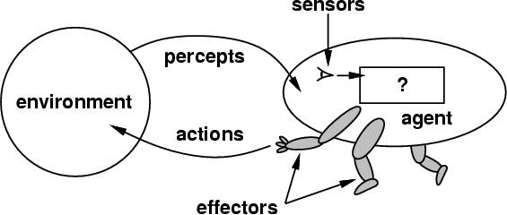
Intelligent Agent
An Intelligent Agent perceives its environment via sensors and acts rationally upon that environment with its effectors. Hence, an agent gets percepts one at a time, and maps this percept sequence to actions.
agent = architecture + program
Agent Properties:
  Rational, Autonomous
  Interacts with other agents plus the environment
  Reactive to the environment
  Pro-active (goal- directed)

Slide 24
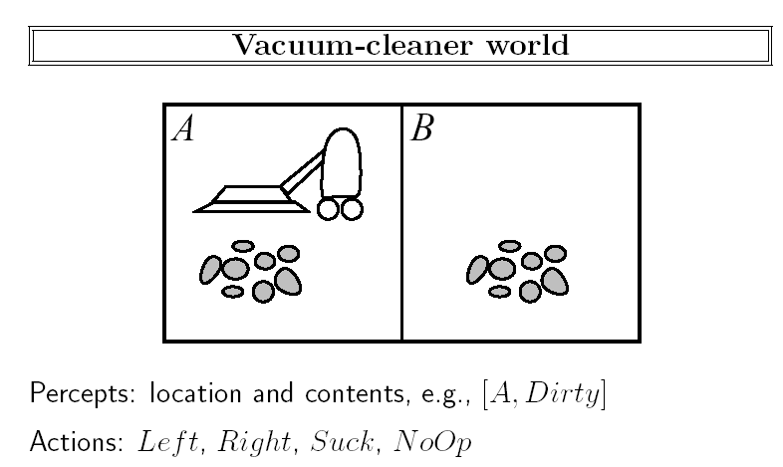
Artificial Agent Examples
Automated taxi driving system Example
Percepts: Video, speedometer, odometer, engine sensors, keyboard input, microphone, …
Actions: Steer, accelerate, brake, speak/display, …
Goals: Maintain safety, reach destination, maximize profits (fuel, tire wear), obey laws, provide passenger comfort, …
Environment: Dhahran streets, freeways, traffic, weather, customers, …, etc.
Different aspects of driving may require different types of agent programs!
Another example:

Slide 25
Artificial Agent Types
Table-driven agents
  use a percept sequence/ action table in memory to find the next action. They are implemented by a (large) lookup table.
Simple reflex agents
  are based on condition-action rules and implemented with an appropriate production (rule-based) system. They are stateless devices, which do not have memory of past world states.
Agents with memory
  have internal state, which is used to keep track of past states of the world.
Agents with goals
  are agents, which in addition to state information have a kind of goal information that describes desirable situations. Agents of this kind take future events into consideration.
Utility-based agents
  base their decision on classic axiomatic utility-theory in order to act rationally.

Slide 26
Properties of Environments
• Accessible/ Inaccessible.
  An environment is accessible if an agent's sensors give it access to the complete state of the environment needed to choose an action.
• Deterministic/ Non-deterministic.
  – An environment is deterministic if the next state of the environment is completely determined by the current state of the environment and the action of the agent.
• Episodic/ Nonepisodic.
  An episodic environment means that subsequent incidences do not depend on what actions occurred in previous incidences.
• Static/ Dynamic.
  – A static environment does not change while the agent is thinking.
• Discrete/ Continuous
  – If the number of distinct percepts and actions is limited the environment is discrete, otherwise it is continuous.
• With/ Without rational adversaries
  – If an environment does not contain other rationally thinking, adversary agents, the agent need not worry about strategic, game theoretic aspects of the environment.

Slide 27
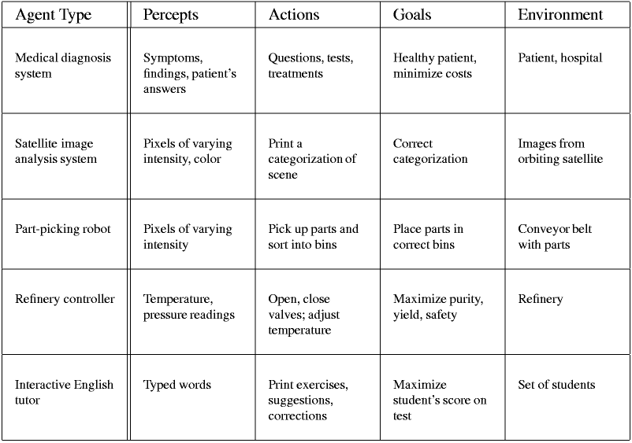
More Examples of Agent Types and their Descriptions
Sensors
State
What the world is like now
How the world evolves
What it will be like if I do action A
What my actions do
Environment
How happy I will be in such a state
Utility
What action I should do now
Effectors

Slide 28

Internet Environments for Agents
Mail
Newsgroups
WWW
FTP (File Transfer Protocol)
MUDs (Multiple User Dimension, Multiple User Dungeon, or Multiple User Dialogue) is a computer program which users can log into and explore
Internet Games: (Chess, Digital Movie, Voice Recognition, …. etc.
The Best Search Engine: Yahoo, Google,… etc.

Slide 29
Summary of Today’s Lecture
Artificial Intelligence involves the study of:
  automated recognition and understanding of speech, images, etc
  learning and adaptation
  reasoning, planning, and decision-making
AI has made substantial progress in
  recognition and learning
  some planning and reasoning problems
AI Applications
  improvements in hardware and algorithms => AI applications in industry, finance, medicine, and science.
AI Research
  many problems still unsolved: AI is a fun research area!
Assigned Reading
  Chapter 1 in the text

